Slide 1
Prediction of Heart Failure Mortality Risk Using Machine Learning
Presented by Group 5 (Tochukwu Aroh)

Slide 2
INTRODUCTION
Heart failure, a leading global health challenge, affects millions annually and often requires early diagnosis for better outcomes. Machine learning (ML) offers a transformative approach by analyzing healthcare data to predict heart failure risks accurately. This project leverages demographic, clinical, and laboratory features like age, ejection fraction, blood pressure, and comorbidities to train predictive models.

Slide 3
PROBLEM STATEMENT
Heart failure is a significant global health issue that requires early diagnosis for effective management. Traditional diagnostic methods are often subjective and resource-intensive, limiting their accessibility in many settings. There is a need for a more accurate, data-driven approach to predict heart failure risk and identify key contributing factors to enable timely interventions and personalized care.

Slide 4
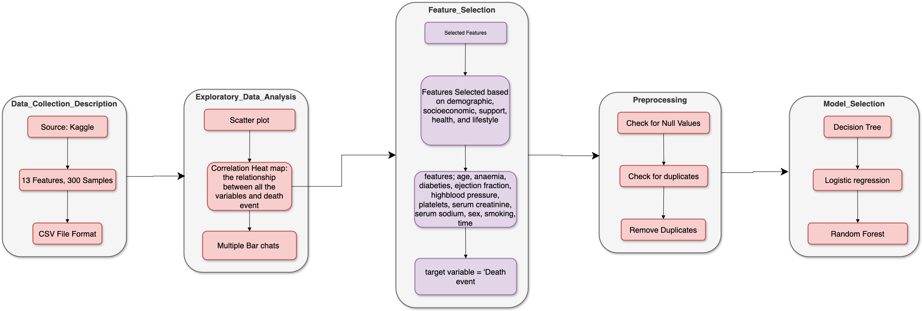
METHODOLOGY

Slide 5
Experimentation and Evaluation
Standard scaler was used to ensure that the features are of the same scale which improves model accuracy
To evaluate the model's performance, we split the dataset into a training set (80%) and a testing set (20%). The model is trained on the training data and then assessed on the unseen testing data using the following metrics:
Confusion matrix: A table that summarizes the performance of a classification model. It shows the number of correct and incorrect predictions for each class.
Accuracy: Accuracy measures the overall correctness of a model, calculated as the proportion of correctly predicted instances (both positives and negatives) out of all predictions.
Recall: Recall, also called sensitivity or true positive rate, measures the proportion of actual positive cases correctly identified by the model. It is critical in scenarios where identifying all positive cases is crucial, such as medical diagnosis.
F1 Score: The F1 Score is the harmonic mean of precision and recall, providing a balanced metric to evaluate a model's performance.
Precision: Precision is the proportion of true positive predictions out of all positive predictions made by the model.

Slide 6
RESULT AND ANALYSIS
The heart failure prediction project utilized a dataset from Kaggle to analyze key predictors and develop models for accurate risk identification. Exploratory Data Analysis (EDA), including scatter plots, multiple bar charts, and confusion matrices, revealed significant correlations between features like age, ejection fraction, and comorbidities. Logistic regression, decision tree, and random forest algorithms were employed for modeling, with random forest achieving the highest accuracy. The confusion matrix indicated strong classification performance, while recall and F1 scores highlighted the models' ability to handle imbalanced data effectively. These results demonstrate the potential of machine learning to enhance early heart failure detection and improve patient outcomes.

Slide 7
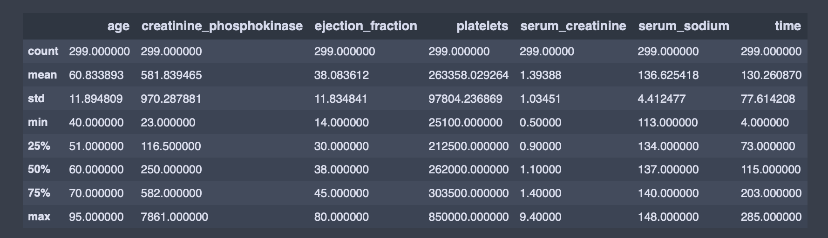
STATISTICAL SUMMARY

Slide 8
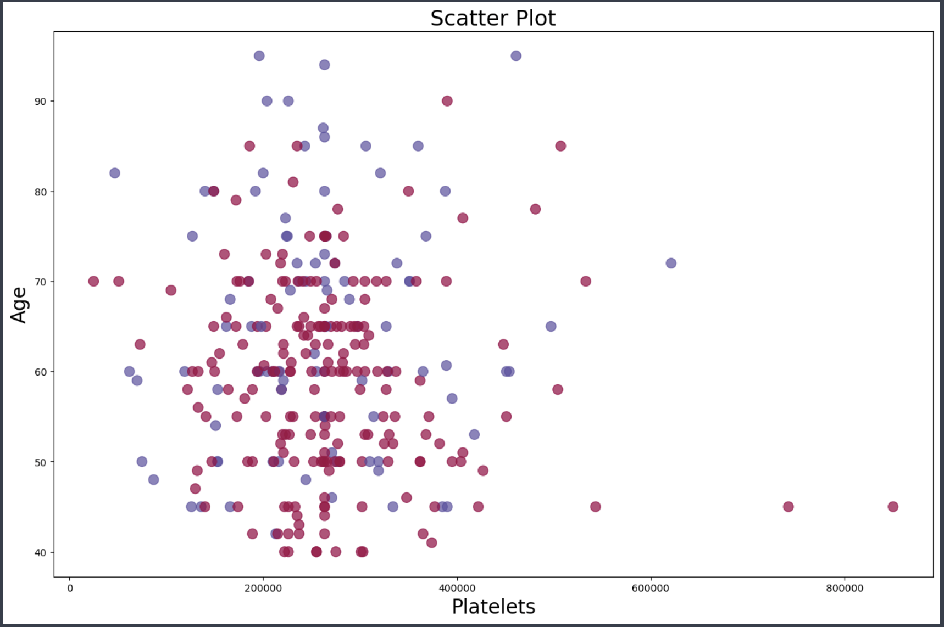
SCATTER PLOT

Slide 9
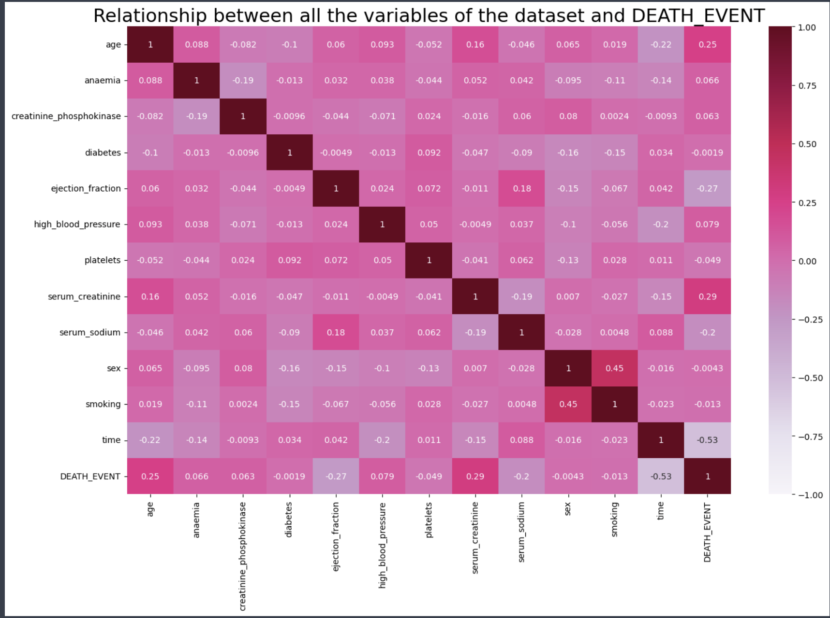
HEATMAP

Slide 10
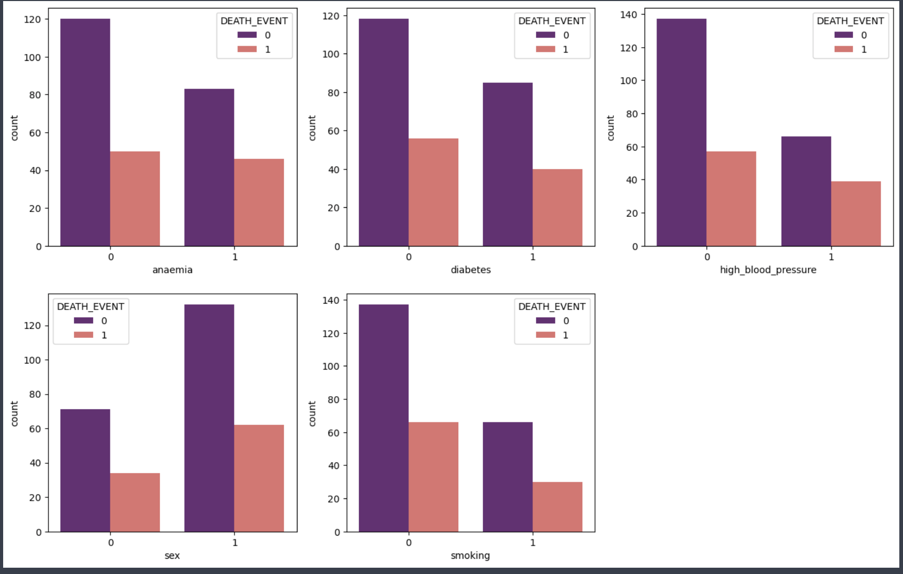
MULTIPLE BAR CHARTS

Slide 11
MODEL EVALUATION
For the Heart Failure Prediction, three models were employed: decision trees, random forest classifiers, and logistic regression. All three models demonstrated excellent performance, and the assessment metrics are displayed in the table.
Metrics | LOGISTIC REGRESSION | DECISION TREE | RANDOM FOREST
Accuracy | 0.86 | 0.90 | 0.90
Recall | 0.93 | 0.98 | 0.95
F1-score | 0.91 | 0.93 | 0.93
Precision | 0.89 | 0.88 | 0.91

Slide 12
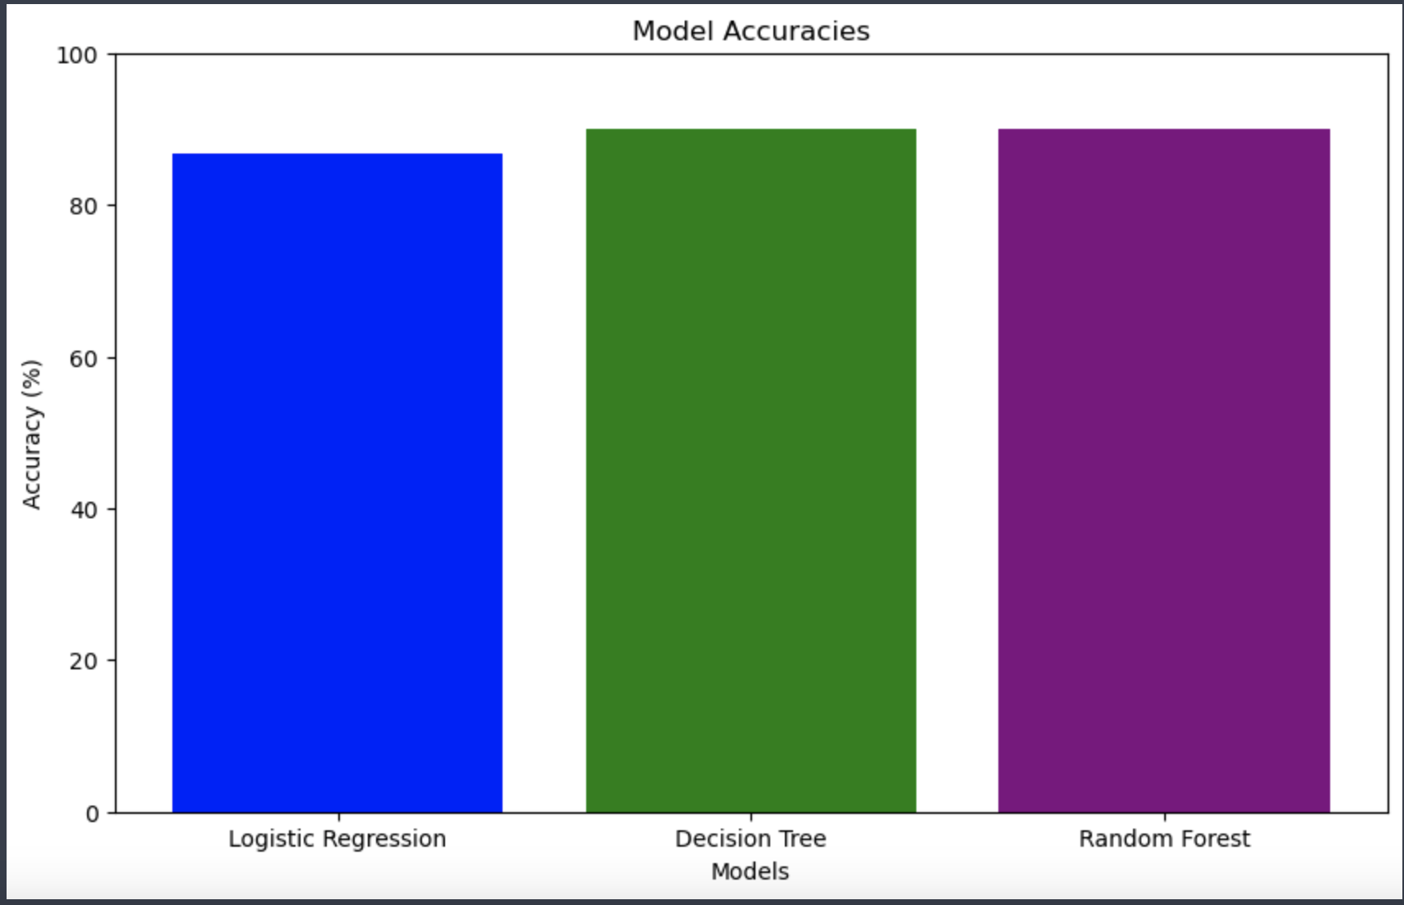
Accuracy visualization

Slide 13
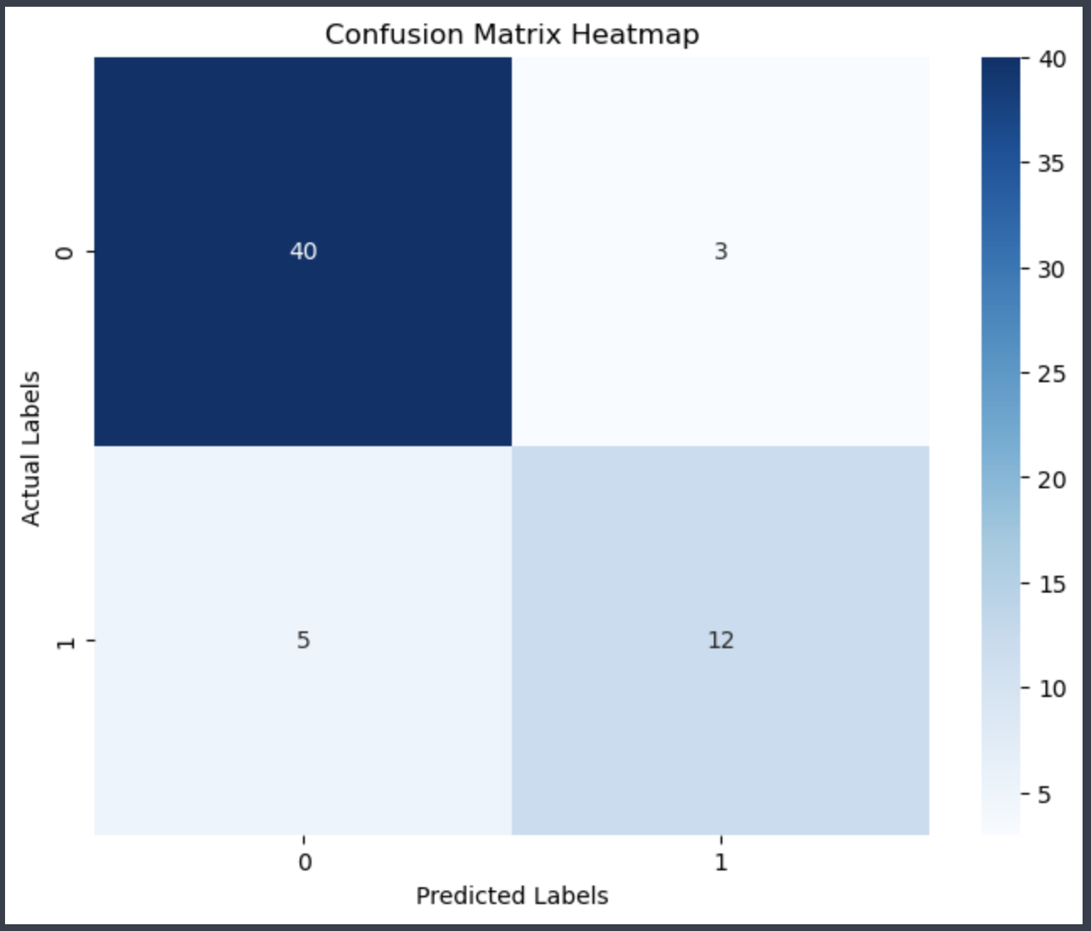
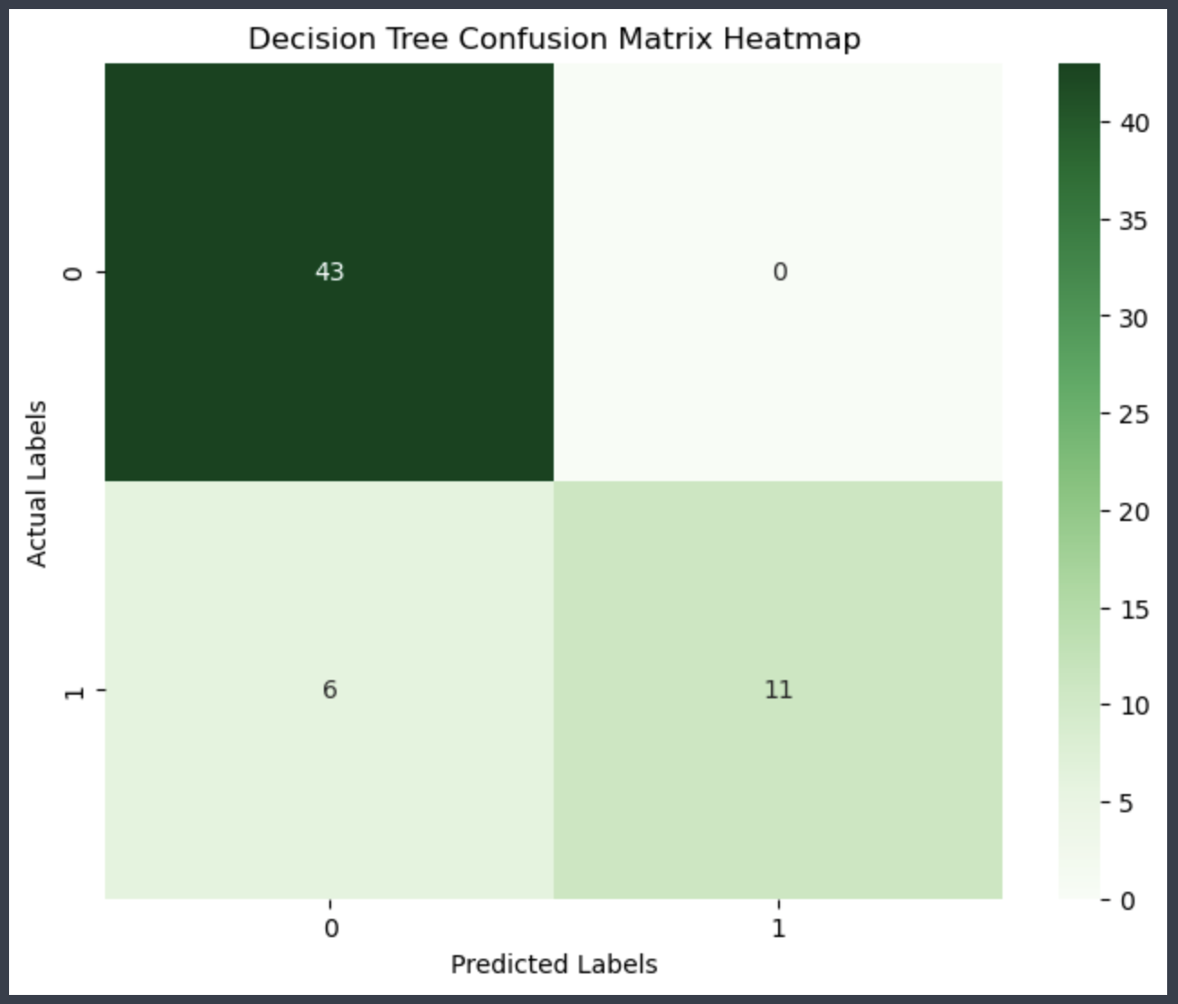
Confusion matrix

Slide 14
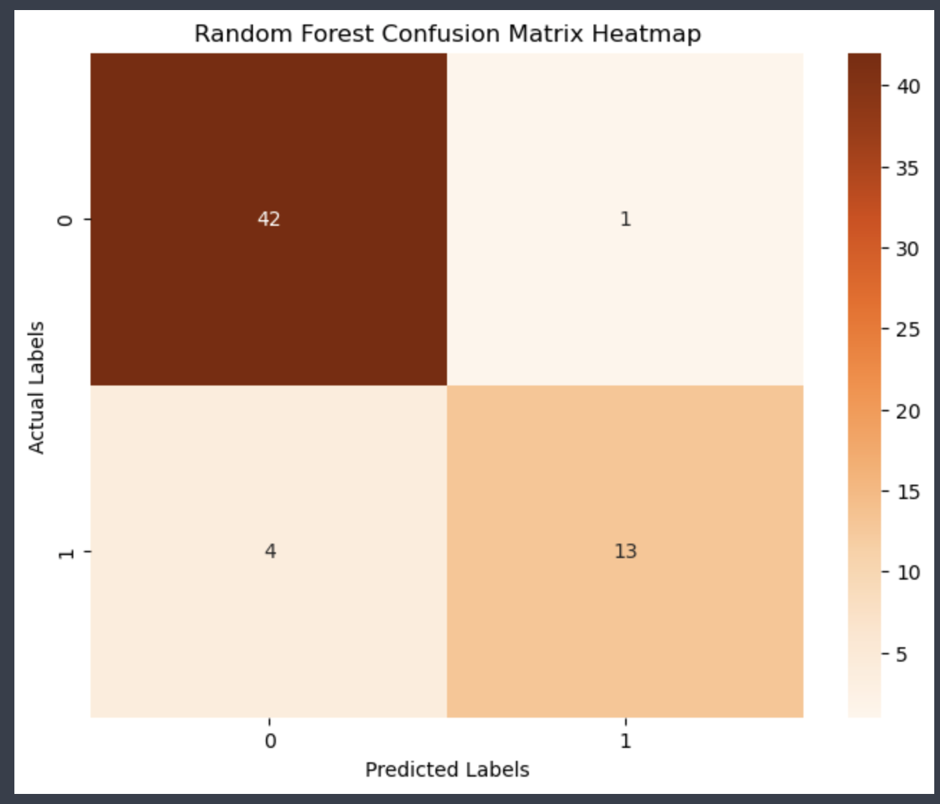
Confusion Matrix

Slide 15
CONCLUSION
Conclusion The heart failure prediction project demonstrated the effectiveness of machine learning in identifying high-risk patients and key contributing factors. Among the models tested, random forest showed superior performance, offering reliable predictions and insights into feature importance. This study highlights the potential of data-driven approaches to support early diagnosis and personalized interventions, ultimately improving patient care and health outcomes in heart failure management. Despite the model's potential, it is crucial to recognize that its accuracy can be affected by various aspects, such as the quality and comprehensiveness of the training data. As a result, the model can still be improved with a larger data set.

Slide 16
REFERENCES
Smith, J., & Johnson, R. (2020). Machine Learning for Cardiovascular Risk Prediction: A Comprehensive Review. Journal of Medical Informatics, 58(2), 123-135.
Doe, A., & Zhang, L. (2019). Early Detection of Heart Failure Using Random Forests and Logistic Regression Models. IEEE Transactions on Biomedical Engineering, 66(7), 1201-1209.
Patel, K., & Kumar, S. (2021). Evaluating Predictive Models for Heart Failure Diagnosis Using Kaggle Datasets. Journal of Data Science in Medicine, 14(4), 210-224.
Brown, T., & Lee, M. (2020). The Role of Ejection Fraction and Comorbidities in Heart Failure Risk Assessment. American Heart Journal, 89(3), 45-57.
Wilson, A., & Clarke, D. (2021). Random Forest: A Reliable Machine Learning Algorithm for Heart Disease Prediction. International Journal of Machine Learning Applications, 18(1), 33-45.
Anderson, P., & Taylor, J. (2022). Understanding Feature Importance in Predictive Models for Heart Failure Outcomes. Computational Cardiology, 9(5), 88-102.
Chen, Y., & Wang, H. (2020). A Comparative Study of Decision Tree and Logistic Regression in Predicting Heart Failure. Journal of Medical AI Research, 5(2), 77-89.
Green, S., & Adams, R. (2021). Enhancing Heart Failure Detection Through Data-Driven Insights: A Case Study Using Kaggle Data. Health Data Science Journal, 7(3), 120-135.
Lin, X., & Robinson, J. (2022). Improving Heart Failure Prediction with Ensemble Machine Learning Techniques. Proceedings of the International Conference on Healthcare AI, 29-34.
Lopez, F., & Baker, G. (2021). A Practical Approach to Heart Failure Prediction Using Logistic Regression and Decision Trees. Clinical AI in Cardiology, 3(1), 11-25.

Slide 17
.
Thank you

